Slide 1

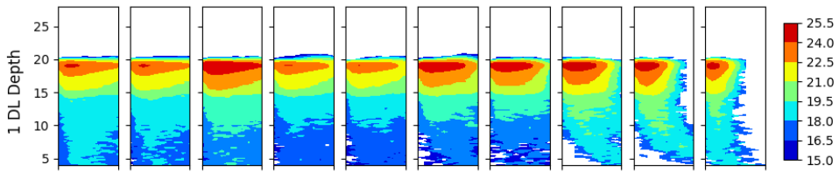
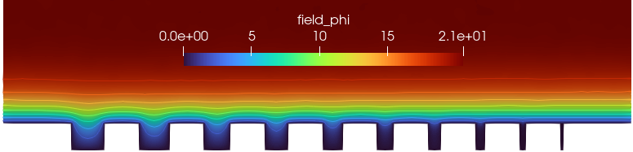
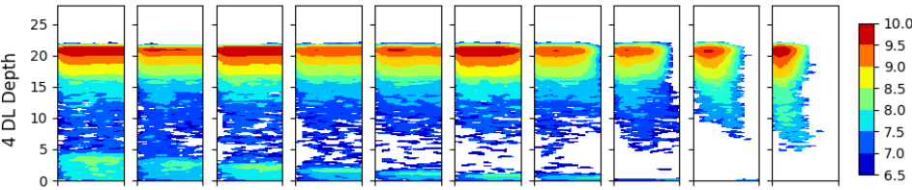
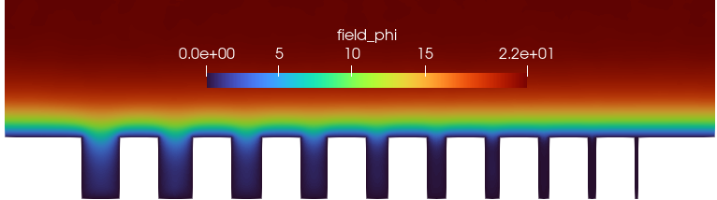

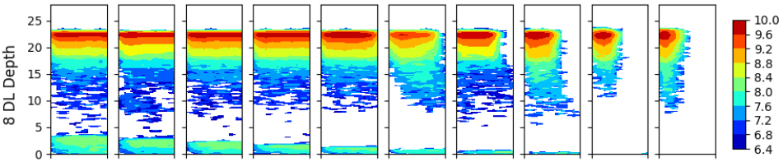
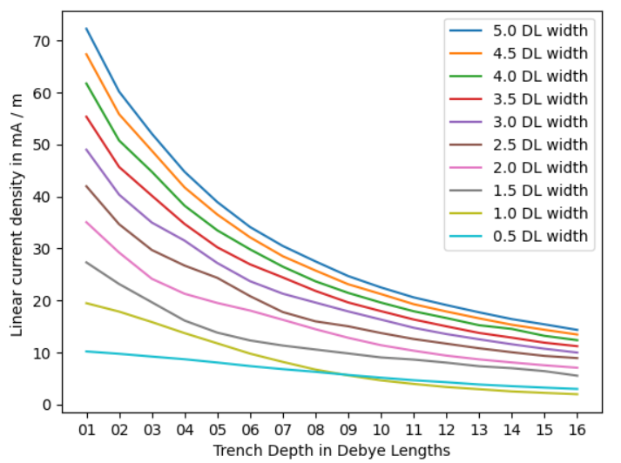

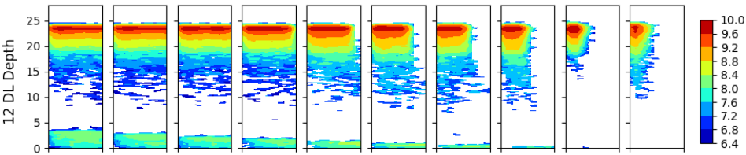
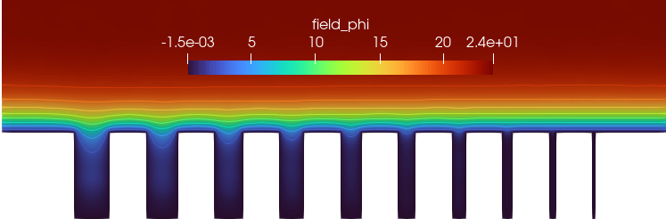



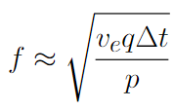
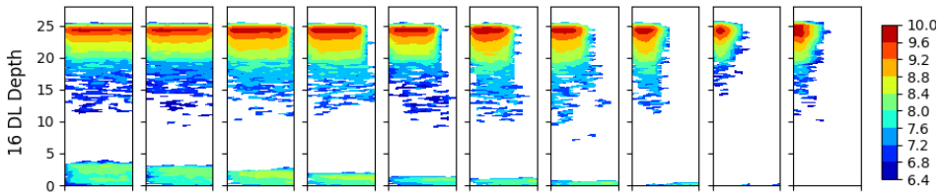
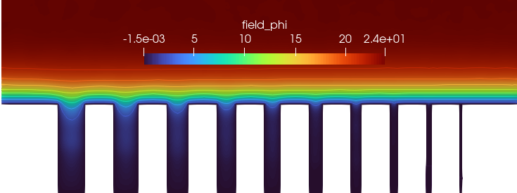
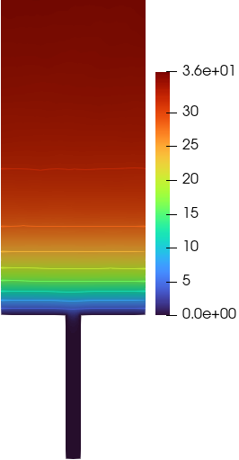
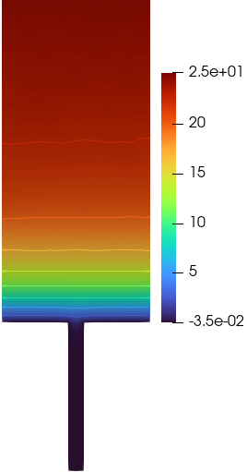
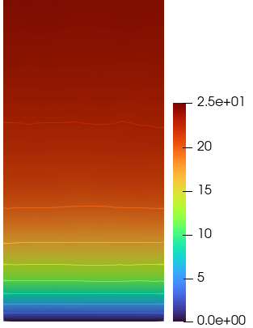
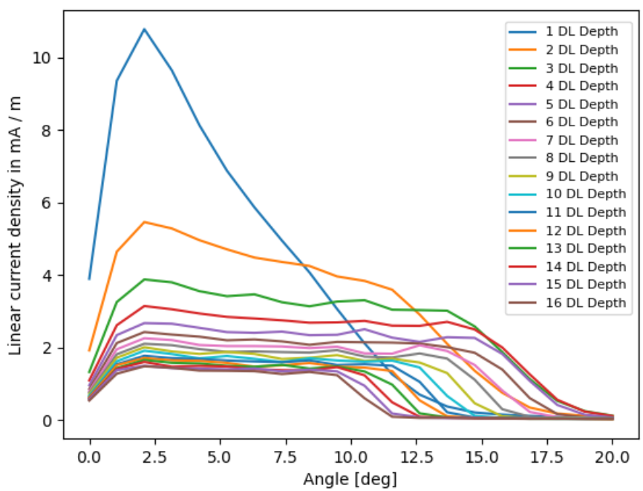
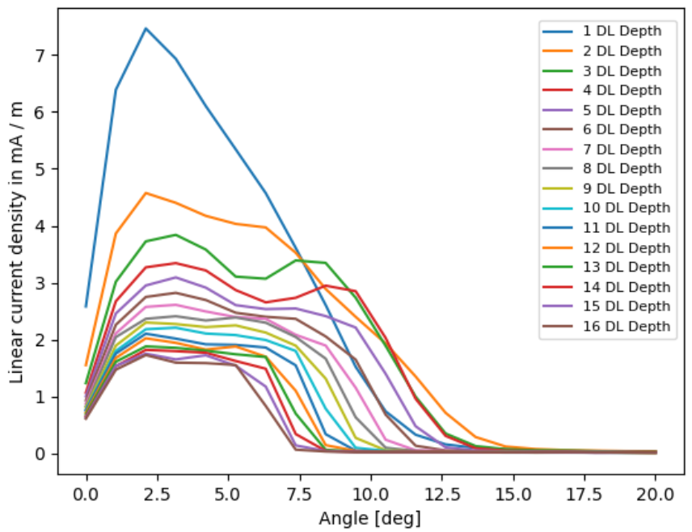
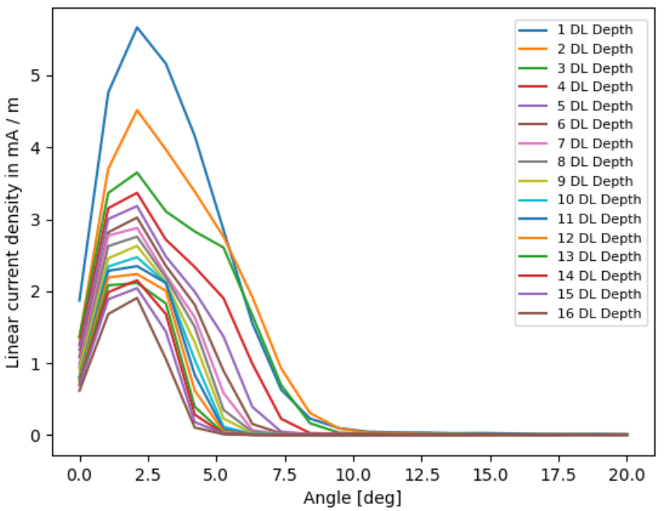
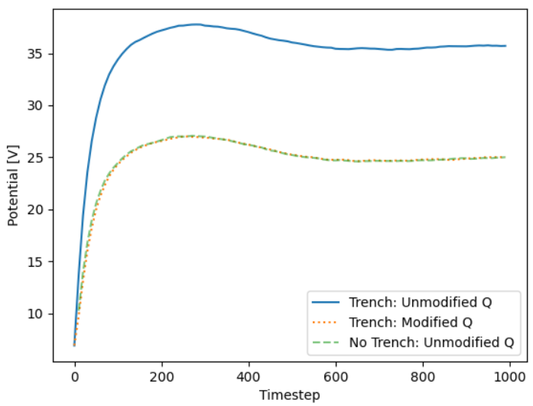

Computational Investigation of Ion Energy Angle Distributions within Trench Structures using the hPIC2 Particle-in-Cell Code
A. Liu^{(a)}, L. Meredith^{(a)}, D. Curreli^{(a)}
(a) University of Illinois at Urbana Champaign, Illinois, USA
Session PP11: Poster Session VI, Poster PP11.00129
65th Annual Meeting of the APS Division of Plasma Physics, Denver, CO, October 31, 2023
Motivation
Plasma-material interactions are sensitive to the Ion Energy-Angle Distribution (IEAD) of the ions impacting on the material walls. Geometric variations in a microstructure on the order of the Debye length can affect the sheath structure and the local material’s response.
hPIC2 [1], a GPU-accelerated electrostatic particle-in-cell code, simulates plasmas in unstructured finite element meshes using the finite element C++ library, MFEM. This is used to model the geometry of various trench structures, enabling a spatially varying IEAD output.
In this work we investigate the effect of varying trench geometry on sheath formation and the IEAD incident on trench surfaces, as well as simulation challenges specific to trench geometries with widths comparable to the Debye length.
Effect of Trench Geometry on IEAD
Effect of Trench Geometry on Plasma Potential Structure
The bulk of this study uses what will be referred to as the “multi-trench geometry”, with the following plasma parameters: n=10¹⁶m⁻³, T_{e} = 4 eV, T_{i} = 300 K, λ_{D} = 148.7 microns, singly ionized Ar⁺.
The multi-trench geometry consists of 10 trenches of decreasing width, starting from 5 λ_{D} and decreasing to 0.5 λ_{D} in intervals of 0.5 λ_{D}.
Trench depths are varied from 1 λ_{D} to 16 λ_{D} in intervals of 1 λ_{D}.
The spacing between trenches is fixed at 5 λ_{D}.
Simulated V_{p} = 21.0 V
Theoretical V_{p} = 18.7 V
4 DL Depth
Methodology
All simulations in this study are resolved in hPIC2 using kinetic ions and Boltzmann electrons.
The charge conservation scheme shown below follows Hagelaar [2], wherein the numerical scheme for reference plasma density n₀ has artificial critical damping, removing a computationally costly timestep constraint.
Hagelaar scheme assumes that all grounded surfaces receive a Maxwellian flux of electrons, an assumption that is not accurate for trenches with widths on the order of the Debye length. This leads to an unphysical discrepancy in plasma potential, for which we propose a correction, which we will refer as the “q-correction”.
In the limit of small trench aperture (w ~ λ_{D}) , we force the q factor to be equal to that of a perfectly flat geometry,
q ~ q_{flat}
In this limit, the presence of trench does not perturb the plasma significantly, which provides the physical basis for our workaround.
Simulated V_{p} = 22.0 V
8 DL Depth
Simulated V_{p} = 24.0 V
12 DL Depth
Simulated V_{p} = 24.0 V
16 DL Depth
Figure 3: Ion currents collected by trench bottoms for the multi-trench geometry and plasma parameters. Each line represents a trench of fixed width, while depth is varied for each of 16 separate simulations. As expected, the current decreases with increasing trench depth, as higher incident angle ions are filtered through wall collisions and (for larger widths) electrostatic lensing. At a depth of 9 λ_{D} (indicated by red arrow), the 0.5 λ_{D} width trench overtakes the 1.0 λ_{D} width trench in ion current due to electrostatic lensing.
Trench without q-correction (V_{p} = 36 V)
Trench with q-correction (V_{p} = 25 V)
Reference Flat Surface (V_{p} = 25 V)
Figure 2: Ion Energy Angle Distributions for the surface at the bottom of trenches for the multi-trench geometry and plasma parameters. The colorbar units are in log₁₀ particles. The angular range is cut off at an upper bound of 10º, encompassing nearly all of the distribution. The collimation of the ions impacting the bottom surface is visible as trenches decrease in width and increase in depth.
Figure 6: Plasma potential plots at various trench depths for the multi-trench geometry and plasma parameters. The isopotential lines are not visibly perturbed when the trench size decreases to roughly 1 λ_{D}. Upon closer examination, even the 1 λ_{D} trench (second from right) has a small amount of electrostatic lensing in comparison to the 0.5 λ_{D} trench, causing the larger ion current described in Figure 3.
“Wide” Trench (w=5.0 λ_{D})
“Medium” Trench (w=3.0 λ_{D})
“Thin” Trench (w=1.0 λ_{D})
BIMODAL DISTRIBUTION DUE TO ELECTROSTATIC LENSING
Conclusions
Ions traverse through trenches of ~1 λ_{D} width with near-vertical incidence; larger trenches have a semi-conformal sheath, resulting in curved isopotential lines and more plasma penetration into the trench.
Strong electrostatic lensing for a 5 λ_{D} trench results in a large spread (>10º) in the ion angular distribution, while a 1 λ_{D} trench collimates the ions into a tight (<5º) angular spread.
The IAD in a 3 λ_{D} trench appears bimodal due to electrostatic lensing, which disappears due to collimation at depths beyond ~5 λ_{D}.
Next Steps: Improve the physical fidelity of the analysis, including important effects which might change the ion impact physics within the trench, including but not limited to: (1) surface charging, (2) neutral physics and collisions via the PIC-MCC module of hPIC2, (3) sputtering within the trench via hPIC2-RustBCA.
ANGULAR SPREAD DUE TO ELECTROSTATIC LENSING
(a)
(b)
(c)
ELECTROSTATIC
LENSING
COLLIMATION
COLLIMATION
Figure 4: Ion Angular Distribution incident on trench bottoms for the multi-trench geometry (width = 5.0 λ_{D}) and plasma parameters. The IADs remain flat as depth increases. The angular spread decreases at higher depth, but spans from ~0º to ~10º even at a depth of 16 λ_{D} due to electrostatic lensing.
Figure 5: Ion Angular Distribution incident on trench bottoms for the multi-trench geometry (width=3.0 λ_{D}) and plasma parameters. The IADs remain relatively flat as depth increases. The angular spread decreases at higher depth, spanning from ~0º to ~5º at a depth of 16 λ_{D}. A peculiar feature is seen at shallow depths; at 2 λ_{D} and 3 λ_{D} there is a bimodal distribution from ions undergoing strong electrostatic lensing. Collisions with the absorbing trench walls at higher depths removes these ions, filtering out higher incident angles.
Figure 6: Ion Angular Distribution incident on trench bottoms for the multi-trench geometry (width = 1.5 λ_{D}) and plasma parameters. The IADs remain relatively flat as depth increases. At a trench width of 1.5 λ_{D}, the IADs’ shape and angular spread is dominated by collisions with the absorbing trench walls. At small trench widths of ~1 λ_{D}, increasing trench depth will collimate the ions hitting the bottom closer to near-vertical incidence, at the expense of decreased ion current.
(d)
Figure 1. Application of our q-correction to the charge conservation scheme (q~q_{flat}) to trench geometry with the following plasma conditions: n=10¹⁶m⁻³, T_{e}=10 eV, T_{i}=10 eV, λ_{D}=166.2 microns, H⁺. Top: (a) plasma potential without q-correction using Hagelaar conservation scheme; (b) plasma potential with q-correction; (c): plasma potential in a flat geometry, used as a reference; (d) temporal evolution of plasma potential, taken at a point 40 λ_{D} from non-trenched surface.
Acknowledgments. This material is based upon work supported by the U.S. Department of Energy, Office of Fusion Energy Sciences under Award No. DE-SC0018141. This work made use of the Illinois Campus Cluster, a computing resource that is operated by the Illinois Campus Cluster Program (ICCP) in conjunction with the National Center for Supercomputing Applications (NCSA) and which is supported by funds from the University of Illinois at Urbana-Champaign.
This material is based upon work supported by the U.S. Department of Energy, Office of Fusion Energy Sciences under Award No. DE-SC0018141.
[1] L. Meredith, M. Rezazadeh, H. Fazlul, V. Srinivasaragavan, O. Sanhni, D. Curreli, hPIC2: a hardware-accelerated, hybrid particle-in-cell code for dynamic plasma-material interactions, Computer Physics Communications, Volume 283, 108569, (2023)
[2] G.J.M. Hagelaar, How to normalize Maxwell–Boltzmann electrons in transient plasma models, Journal of Computational Physics, Volume 227, Issue 2, Pages 871-876, (2007)
https://github.com/lcpp-org/aps-dpp-2023-liu

